Slide 1
Advanced Databases Lecture 6: Dimensional Modelling, Conversion from ER to Star Schema
Dr. Pierpaolo Dondio,

Slide 2
Topics
Dimensional Modeling
Differences with ER
ER / DM Conversion
Examples
Hierarchical Dimensions

Slide 3
1. Introduction to Dimensional Modeling

Slide 4
Why Dimensional Data Warehouses?
Business needs to analyze data so that it can:
Understand trends
Predict future behavior and needs
Personalize contact with customers
Be competitive
All of this in a speedy manner, with the ability to do “What if’s”

Slide 5
Dimensional Data Warehouse Architecture
Relational Data
External Data
Enterprise Data
Data Distribution
Acquisition, Staging, Cleaning,
Transformation
Data Warehouse
Storage
Analytical
Applications

Slide 6
Some Key points
The Datawarehouse is a database (and it can be built using a relational DB like Oralce)
It is not a live / day-by-day database
Dab-by day transactions go to another database(s), usually fully relational databases fully normalized
A DW:
s updated at specific points in time
is mainly read-only (analytics)
is optimized for (read) performances
is a collection (integration) of different sources
The “yellow” box (= the staging area) is permanent and it is where data are clean and integrated

Slide 7
Some Definitions..

Slide 8
Definition – continued…

Slide 9
Definition – continued…

Slide 10
DW Requirements
Kimball 2002

Slide 11
DW Requirements

Slide 12
DW Requirements

Slide 13
DW Requirements

Slide 14
DW Requirements

Slide 15
DW Requirements

Slide 16
DW Requirements

Slide 17
What is a Dimensional Model?

Slide 18
Northwind Database Model – Relational Format

Slide 19
Northwind Database – Star Schema – Orders

Slide 20
What is Dimensional Modeling?
DM is a logical design technique that seeks to present the data in a standard, intuitive framework that allows for high-performance access.
Can be implemented using a relational or a DBMS
Every dimensional model is composed of one table with a multipart key, called the fact table, and a set of smaller tables called dimension tables.
Each dimension table has a single-part primary key that corresponds exactly to one of the components of the multipart key in the fact table.
This characteristic "star-like" structure is often called a star join. The term star join dates back to the earliest days of relational databases.

Slide 21
Star Schema
Fact
Dim
Dim
Dim
Dim
Dim
Singe data (fact) table surrounded by multiple descriptive (dimension) tables

Slide 22
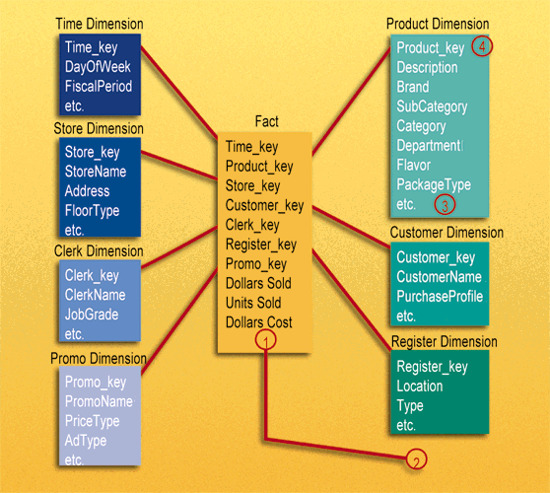
Dimensional Model Example

Slide 23
Dimensional Schema
Fact Tables
contain related measures
Usually the largest tables
Usually appended to
Can contain detail or summary data
Measures are usually additive
Dimension Tables
Contain descriptors
Utilize business terminology
Textual and discrete data
Attributes through which the table measures are analyzed

Slide 24
Dimensional Model: Fact Tables
A fact table contains information about things that an organization wants to measure.
A fact table’s key is made up from the keys of two or more parents.
A fact always ‘resolves’ a many-to-many relationship between the parent, or dimension tables.
The most useful fact tables also contain one or more numerical measures, or facts, that occur for the combination of keys that define each record.
Example: the facts are Dollars Sold, Units Sold, and Dollars Cost.

Slide 25
Dimensional Model: Fact Tables
The most useful facts in a fact table are numeric and additive.
Additivity is crucial because data warehouse applications almost never retrieve a single fact table record; rather, they fetch back hundreds, thousands, or even millions of these records at a time, and often the most useful thing to do with so many records is to add them up.

Slide 26
Dimensional Model: Dimension Tables
Dimension tables contain information about how an organization wants to analyze facts:
“Show me sales revenue (fact) for last week (time) for blue cups (product) in the western region (geography)
Dimension tables most often contain descriptive textual information ‘Blue cups’, ‘Western Region’
Dimension attributes are used as the source of most of the interesting ‘constraints’ in data warehouse queries., and they are virtually always the source of the row headers in the SQL answer set.

Slide 27
Dimensions vs Facts
Dimensions
The time independent, textual and descriptive attributes by which users describe objects.
Combining all the attributes including hierarchies, rollups and sub-references into a single dimension is denormalization.
Often the “by” word in a query or report
Not time dependent
Facts
Business Measurements
Most Facts are Numeric
Additive, Semi-Additive, Non-Additive
Built from the lowest level of detail (grain)
Very Efficient
Time dependent

Slide 28
Benefits
Performance (Integer relationships, natural partitioning, Single joins benefit SQL optimizer)
Supports Change management
Usability/Simplicity (easy to read, interpret, join, calculate)
Presentation (Consistency, Taxonomy, Labeling)
Reuse (Conformed dimensions reduce redundancy, Role-plays)

Slide 29
Entity Relationship (ER)
Vs.
Dimensional Modeling (DM)

Slide 30
Entity Relationship Modeling: Review
Entity Relationship modeling is a technique used to ‘abstract’ user’s data requirements into a model that can be analyzed and ultimately implemented.
The focus of ER modeling:
achieve processing and data storage efficiency by reducing data redundancy (storing data elements once)
provide flexibility and ease of maintenance
protect the integrity of data by storing it once
ER modeling and normalization great for transaction processing as it makes transactions as simple as possible (as data stored only in one place)

Slide 31
Relational Normal Form
Most relational databases are set to 3rd normal form
1st Normal form – Tables have unique keys and no repeating groups or multi-value fields
2nd Normal form – Every attribute is dependent ont the entire key of the table
3rd Normal form – Attributes are dependent only on the key. No derived elements

Slide 32
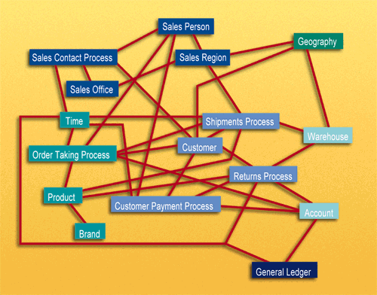
ER Model Example
Normalized databases become very complex making queries difficult and inefficient – a ‘spiderweb of joins’ is required for many queries. A database normalized for transaction processing is typically unusable for non-technical users who wish to perform queries

Slide 33
Drawbacks to Relational Data Structures
Data is not structured for analytical usage
Multiple Joins are resource intensive
Missing data from external sources, context history, not operational sources

Slide 34
Step 4 - Identify the Facts
Must be true to the grain defined in step 2.
Typical facts are numeric additive figures.
Facts that belong to a different grain belong in a separate fact table.
Facts are determined by answering the question, “What are we measuring?”
Percentages and ratios, such as gross margin, are non-additive. The numerator and denominator should be stored in the fact table.

Slide 35
ER model issues
End users cannot understand or remember an ER model. End users cannot navigate an ER model. There is no graphical user interface (GUI) that takes a general ER model and makes it usable by end users.
Software cannot usefully query a general ER model. Cost-based optimizers that attempt to do this are notorious for making the wrong choices, with disastrous consequences for performance.
Use of the ER modeling technique defeats the basic allure of data warehousing, namely intuitive and high-performance retrieval of data.
The solution: the Dimensional Data Model

Slide 36
Dimensional Model vs ER model
The key to understanding the relationship between DM and ER is that a single ER diagram breaks down into multiple DM diagrams, or ‘stars’.
Think of a large ER diagram as representing every possible business process within an application. The ER diagram may have Sales Calls, Order Entries, Shipment Invoices, Customer Payments, and Product Returns, all on the same diagram.

Slide 37
Dimensional Model vs ER model
Returns
Orders
Sales Contact
Payments

Slide 38
Dimensional Model vs ER model
To create the individual ‘stars’ that exist within an application:
Look for many-to-many relationships in the ER model containing numeric and additive facts and to designate them as fact tables.
Alternatively, look for ‘events’ or ‘transactions’ – these may also be facts
Denormalize all of the remaining tables into flat tables with single-part keys that connect directly to the fact tables. These tables become the dimension tables.
In cases where a dimension table connects to more than one fact table, we represent this same dimension table in both schemas, and we refer to the dimension tables as "conformed" between the two dimensional models.

Slide 39
DM Strengths
The dimensional model has a number of important data warehouse advantages that the ER model lacks.
First, the dimensional model is a predictable, standard framework. Report writers, query tools, and user interfaces can all make strong assumptions about the dimensional model to make the user interfaces more understandable and to make processing more efficient.
Rather than using a cost-based optimizer, a database engine can make very strong assumptions about first constraining the dimension tables and then "attacking" the fact table all at once with the Cartesian product of those dimension table keys satisfying the user's constraints.

Slide 40
DM Strengths
A second strength of the dimensional model is that the predictable framework of the star join schema withstands unexpected changes in user behavior. Every dimension is equivalent. All dimensions can be thought of as symmetrically equal entry points into the fact table. The logical design can be done independent of expected query patterns. The user interfaces are symmetrical, the query strategies are symmetrical, and the SQL generated against the dimensional model is symmetrical.

Slide 41
DM Strengths
A third strength of the dimensional model is that it is ‘gracefully extensible’ to accommodate unexpected new data elements and new design decisions.
Gracefully extensible:
all existing tables (both fact and dimension) can be changed in place by simply adding new data rows in the table, or the table can be changed in place with a SQL alter table command.
Data should not have to be reloaded.
No query tool or reporting tool needs to be reprogrammed to accommodate the change.
Old applications continue to run without yielding different results. Adding new unanticipated facts (that is, new additive numeric fields in the fact table), as long as they are consistent with the fundamental grain of the existing fact table

Slide 42
DM Strengths
A fourth strength of the dimensional model is that there is a body of standard approaches for handling common modeling situations in the business world. These modeling situations include:
Slowly changing dimensions, where a "constant" dimension such as Product or Customer actually evolves slowly and asynchronously.

Slide 43
DM Strengths
A final strength of the dimensional model is the management of aggregates.
Aggregates are summary records that are logically redundant with base data already in the data warehouse, but they are used to enhance query performance.
A comprehensive aggregate strategy is required in every medium- and large-sized data warehouse implementation.
All of the aggregate management software packages and aggregate navigation utilities depend on a very specific single structure of fact and dimension tables that is absolutely dependent on the dimensional model.

Slide 44
ER vs DM – Final Points
ER models are not appropriate for Data Warehouses. ER modeling does not really model a business; rather, it models the micro relationships among data elements.
ER models are wildly variable in structure. As such, it is extremely difficult to optimize query performance.

Slide 45
Dimensional Modeling
Conversion
From ER Diagram to Dimensonal Model

Slide 46
Modeling Design Process
Identify the Business Process
Source of “measurements”
Identify the Grain
What does 1 row in the fact table represent or mean?
Identify the Dimensions
Descriptive context, true to the grain
Identify the Facts
Numeric additive measurements, true to the grain

Slide 47
Step 1 - Identify the B. Process
This is a business activity typically tied to a source system.
Not to be confused with a business department or function. An Orders dimensional model should support the activities of both Sales and Marketing.
“If we establish departmentally bound dimensional models, we’ll inevitably duplicate data with different labels and terminology.”

Slide 48
Step 2 - Identify the Grain
The level of detail associated with the fact table measurements.
A critical step necessary before steps 3 and 4.
Preferably it should be at the most atomic level possible.
“How do you describe a single row in the fact table?”

Slide 49
Step 3 - Identify the Dimensions
The list of all the discrete, text-like attributes that emanate from the fact table.
They are the “by” words used to describe the requirements.
Each dimension could be though of as an analytical “entry point” to the facts.
“How do business people describe the data that results from the business process?”

Slide 50
ER/DM Conversion
4-step process:
Identify the business process from the E/R model.
Identify many-to-many tables in the E/R model to convert to fact tables.
Denormalize remaining tables into flat dimension tables.
Identify date and time from the E/R model.

Slide 51
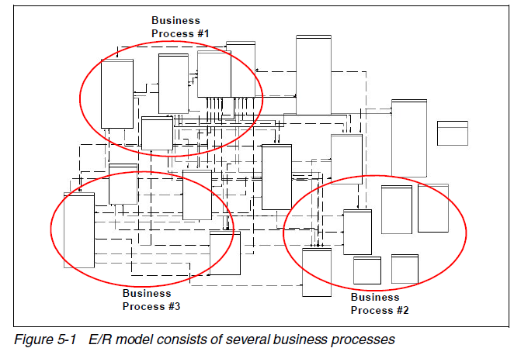
Identify BP

Slide 52
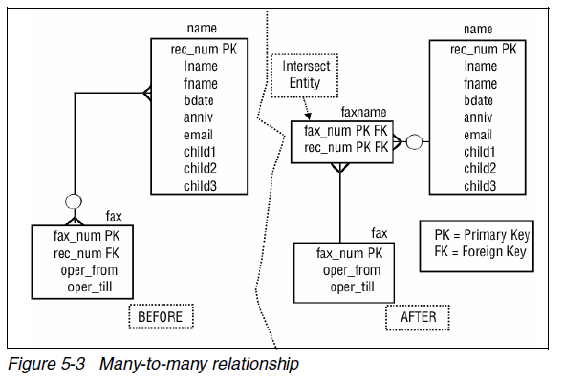
Many-to-Many
They represent the link between dimensions
They usually help to identify transactional tables

Slide 53
Transaction Tables
The idea behind this step is to identify the transaction-based tables that serve to express many-to-many relationships inside an E/R model.
Every E/R model consists of transaction-based tables which constantly have data inserted, or are updated with data, or have data deleted from them.
For example, in an ERP database, there are transaction tables, such as Invoice and Invoice_Details, which are constantly inserted and updated because they are transaction-based tables.
Tables such as Employee and Products in an E/R model may be fairly static.

Slide 54
Transactional / Non Transactional
What are a transaction-based table?
generally involved in storing facts and measures about the business.
They generally store foreign keys and facts, such as quantity, sales price,
profit, unit price, and discount.
In transaction tables, records are usually inserted, updated, and deleted as and when the transactions occur.
Such tables represent many-to-many relationships between non-transaction-based tables.
larger in volume and grow in size much faster than the non-transaction-based tables.
What are a non-transaction-based tables?
generally involved in storing descriptions about the business.
They describe entities such as products, product category, product brand..
In non-transaction tables, records are usually inserted and there
are fewer updates and deletes.
Such tables are far smaller in volume and grow very slowly in size, compared to the transaction-based tables.

Slide 55
Denormalization
taking the remaining tables in the E/R model and denormalizing them into dimension tables for the dimensional model.
The primary key of each of the dimensions is made a surrogate (non-intelligent,
integer) key.
This surrogate key connects directly to the fact table

Slide 56
Date and Time
The last step generally involves identifying the date and time dimension.
Dates are generally stored in the form of a date timestamp column inside the E/R
model.
date and time-related columns are generally found in the transaction-based tables.

Slide 57
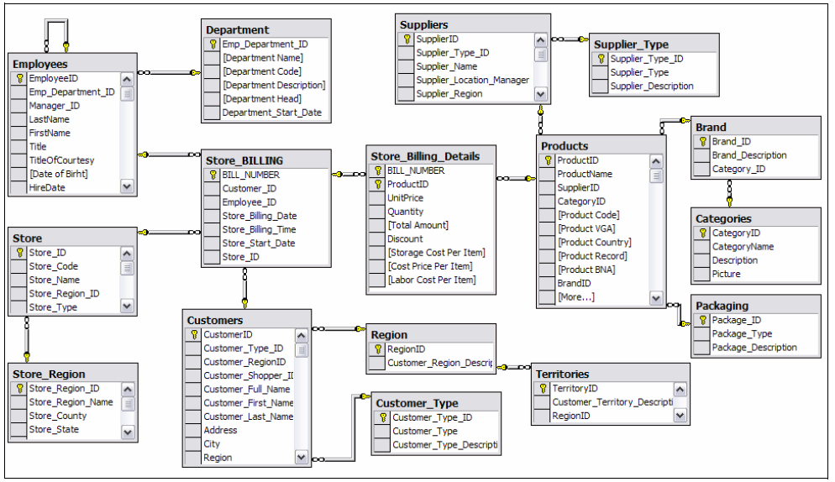
Example of ER/DM Conversion

Slide 58
Identify BP – Retail Sales

Slide 59
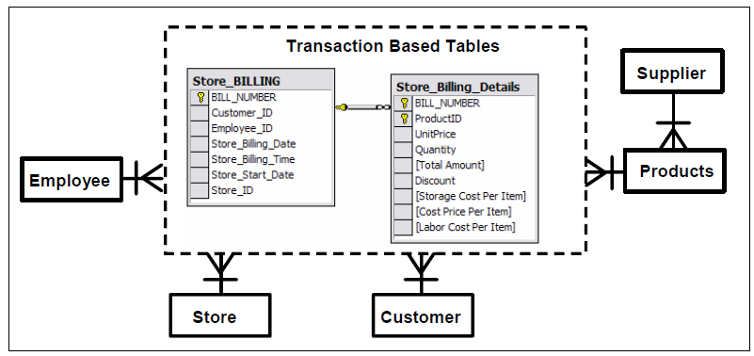
Transaction-Based Table, Many to Many

Slide 60
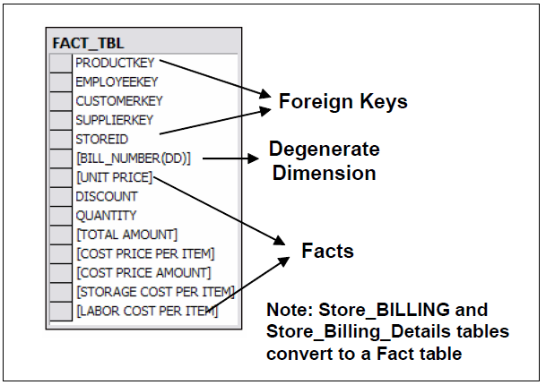
Fact Table

Slide 61
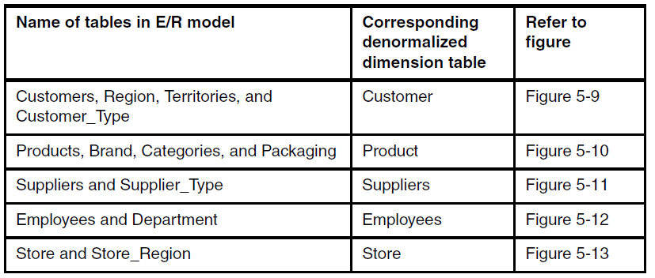
Dimensions Denormlization

Slide 62
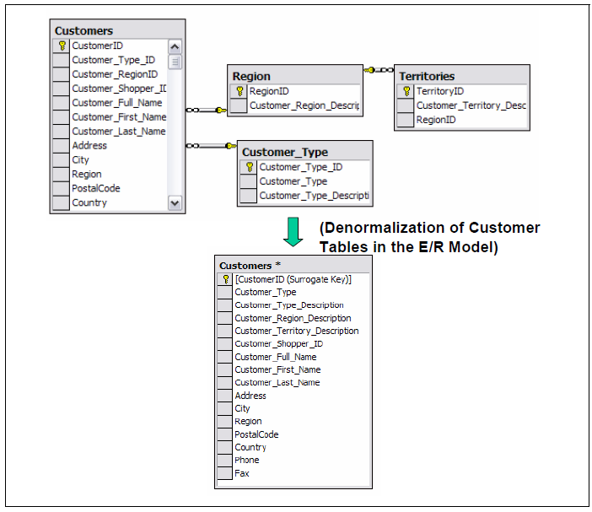
Customers

Slide 63
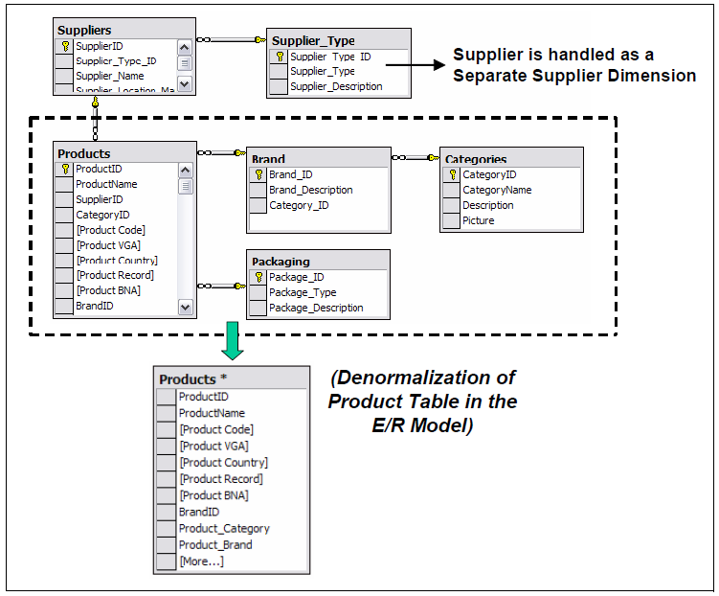
Product

Slide 64
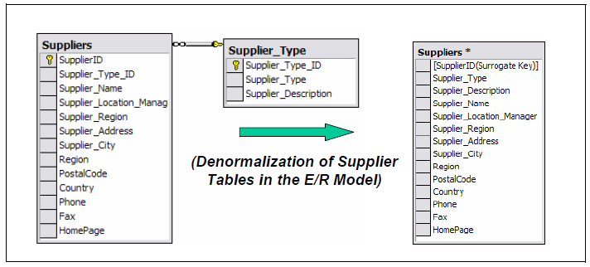
Suppliers

Slide 65
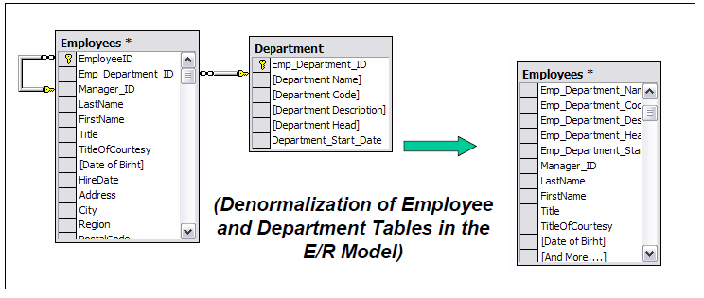
Employee

Slide 66
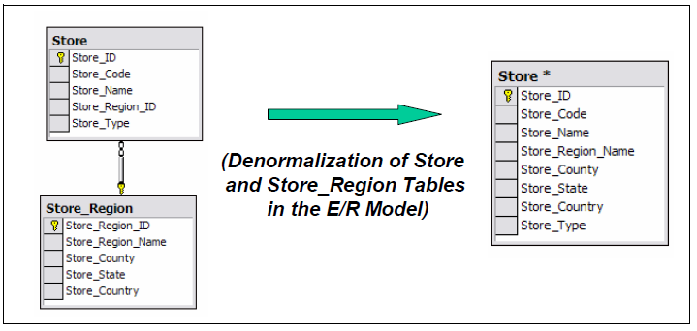
Store

Slide 67
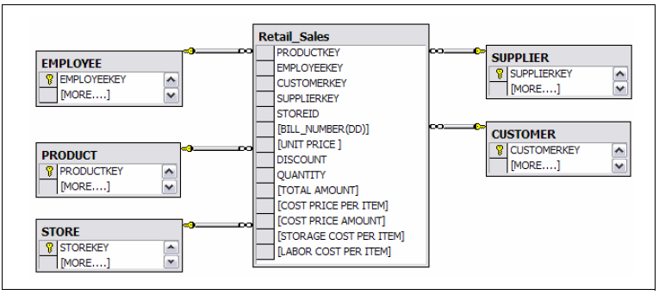
Final Star Schema

Slide 68
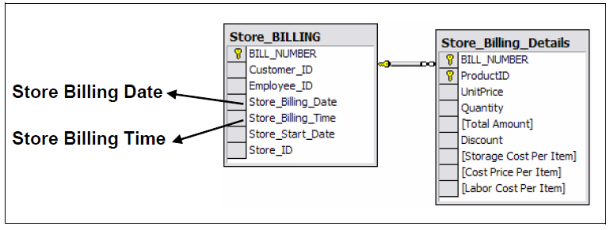
Date and Time Identification

Slide 69
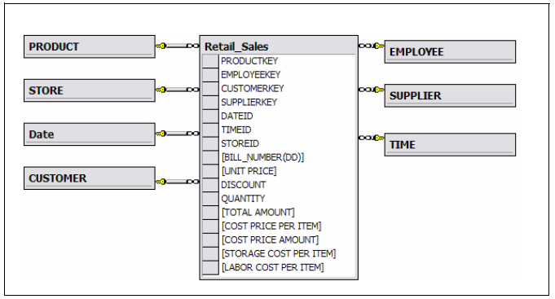
Final Schema

Slide 70
Grain
Different Grain for Different Facts
3 Types of Facts
Comparisons
How it affects the performance of the Databases

Slide 71
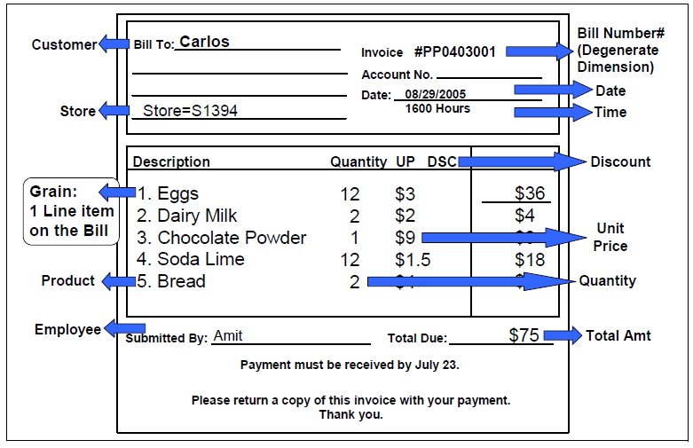
Grain
The lowest level of data represented in a fact table is defined as grain
It is important to have the grain defined at the most detailed, or atomic, level.
When data is defined at a very detailed level, the grain is said to be high. When there is less detailed data, the grain is said to be low.
For example, for date, a grain of year is a low grain, and a grain of day is a high grain.
In general, there are separate separate grains for a single business process.

Slide 72
Grain and DB Size
The granularity of the fact table determines how much storage space will be required for the database.
For example, consider the following possible granularities for a fact table:
Product by day by region
Product by month by region
The size of a database that has a granularity of product by day by region would be much greater than a database with a granularity of product by month by region because the database contains records for every transaction made each day as opposed to a monthly summary of the transactions. You must carefully determine the granularity of your fact table because too fine a granularity could result in a huge database. Conversely, too coarse a granularity could mean the data is not detailed enough for users to perform meaningful queries.

Slide 73
One or many fact tables?
When designing the dimensional model for a business process(es), one or more fact tables can be created.
Here are guidelines to consider:
Facts that are not true (valid) to any given grain should not be forced into the dimensional model. Often facts that are not true to a grain definition belong to a separate fact table with its own grain definition.
Dimensions that are not true (valid) to any given grain should not be forced into the dimensional model. Often such dimensions belong to a separate dimensional model with its own fact table and grain.
Separate fact tables (dimensional models) should always be created for each unique business process.
A single business process may consist of more than one dimensional model. Do not force fit the different facts and dimensions which belong to different dimensional models into a single star schema. We strongly recommend that separate grains are identified for a business process when you are not able to fit facts or dimensions in a single star model.

Slide 74
Different Fact Tables
Transaction Fact Table
Periodic Fact Table
Accumulating Fact Table
Different Grains
Transaction and Period: only insert
Accumulating: insert and updated

Slide 75
Transaction Fact Table
A transaction-based fact table is a table that records one row per transaction
Money Withdrawn: $400, Date: August 2, 2005, Time: 4:00AM
Money Deposited: $300, Date: August 4, 2005, Time: 3:00AM
Money Withdrawn: $600, Date: August 5, 2005, Time: 2:00PM
Money Withdrawn: $900, Date: August 6, 2005, Time: 9:00PM
A single row is inserted for each transaction.
Typically, the date and time dimensions are represented at the lowest level of detail.
The transaction fact table is known to grow very fast as the number of transactions increases.

Slide 76
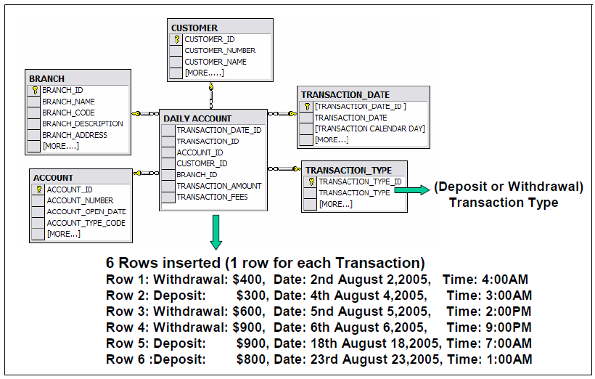
Transaction Table Example

Slide 77
Periodic Fact Table
A periodic fact table stores one row for a group of transactions made over a period of time
A single row is inserted for each set of activities over a period of time.
Typically, the date and time dimensions are represented at the higher level of detail.
The periodic fact table is known to grow comparatively slowly in comparison
to the transaction fact table.

Slide 78
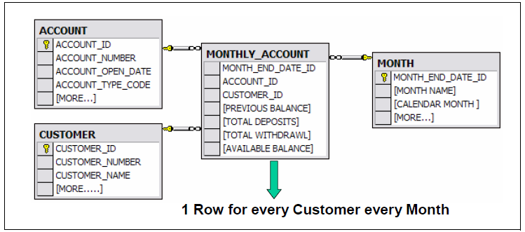
Periodic Fact Table Example

Slide 79
Accumulating Fact Table
An accumulating fact table stores one row for the entire lifetime of an event.
For example, from the lifetime of a credit card application being sent to the time it is accepted.
Accumulating fact tables are typically used for short-lived processes

Slide 80
Accumulating Fact Table / Example
Consider that a big recruitment company advertises vacancies in many jobs relating to software, hardware, networking, apparel, marketing, sales, food, carpentry, plumbing, housing, house repairs, mechanical, teaching high school, teaching college, senior management, and working in restaurants. About 100 000 vacancies are advertised, in all major newspapers every month. The recruitment company senior management wants to better understand how efficiently their recruitment staff works in matching potential job candidates with the jobs they seek. The senior management wants to understand how long it takes for a prospective candidate to get a job from the time the resume is sent for a particular job vacancy.

Slide 81
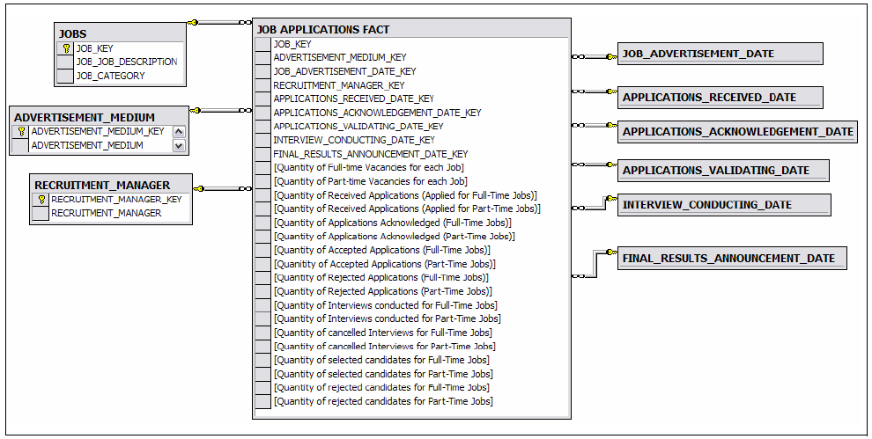
Accumulating Fact Table / Example

Slide 82
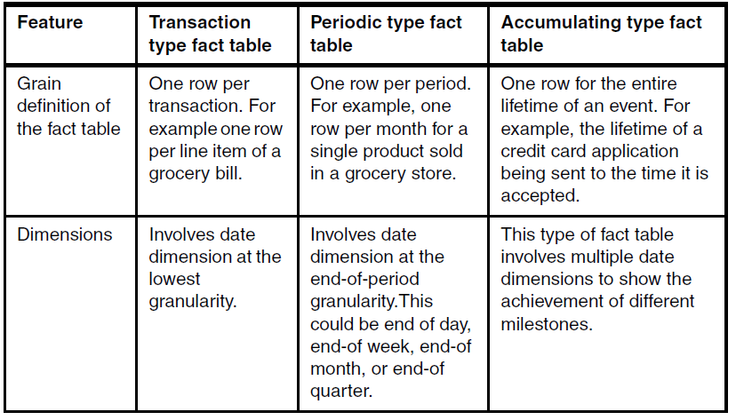
Comparison of Fact Tables /1

Slide 83
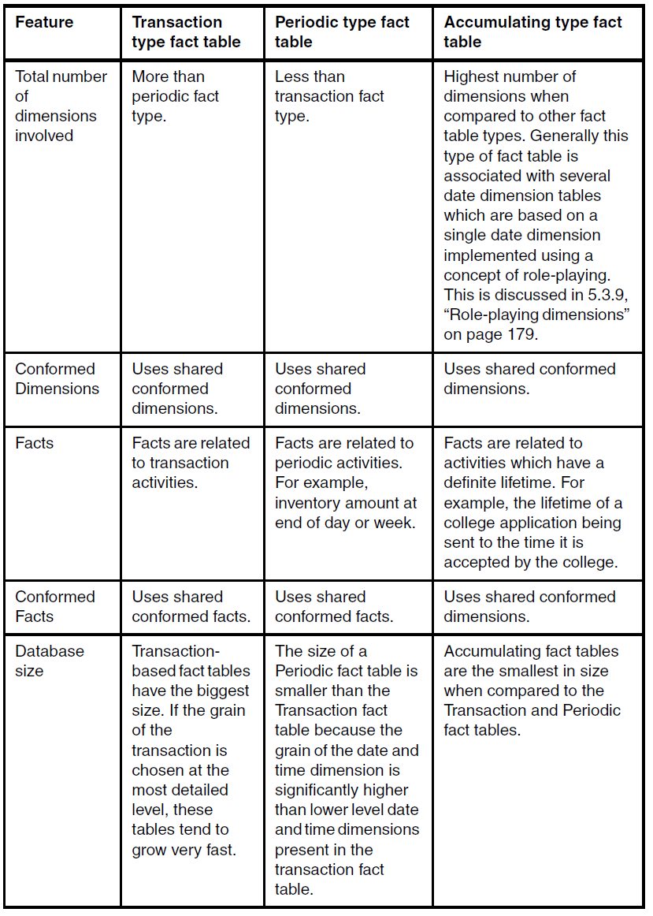

Slide 84
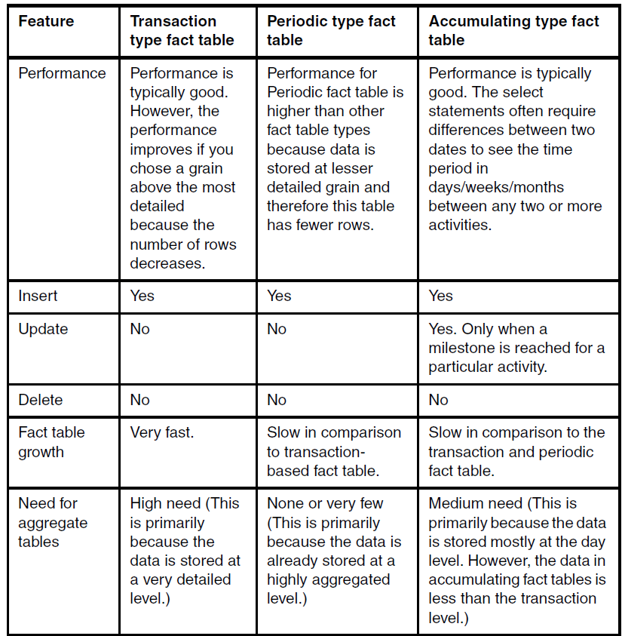

Slide 85
Hierarchical Dimensions
A hierarchy is a cascaded series of many-to-one relationships and consists of different levels.
Each level in an hierarchy corresponds to a dimension attribute.
Hierarchies document the relationships between levels in a dimension.
For example, a region hierarchy is defined with the levels Region, State, and City
Hierarchies enrich the semantics of data in a dimensional model and correspondingly improve the class of interesting and meaningful queries that can be run against it.
In order to generate data for a report, we can drill down or up on attributes from more than one explicit hierarchy and with attributes that are part of no hierarchy.

Slide 86
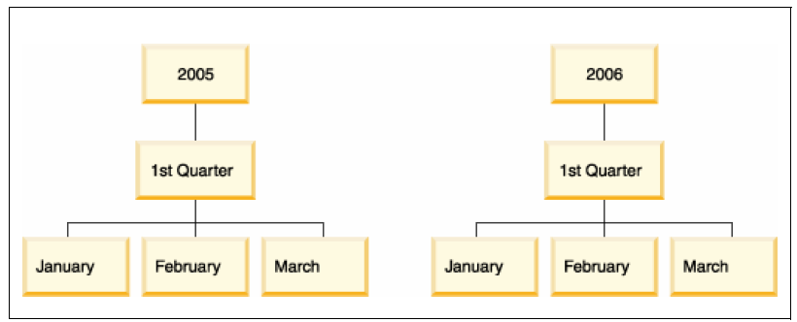
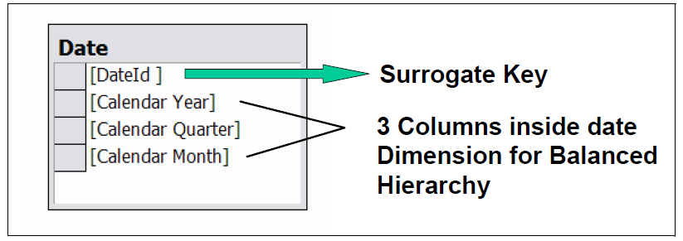
Balanced Hierarchy
A balanced hierarchy is one in which all of the dimension branches have the same number of levels.
The logical parent of a level is directly above it.
Example: a date where the meaning and depth of each level, such as Year, Quarter, and Month, are consistent. They are consistent because each level represents the same type of information, and each level is logically equivalent

Slide 87
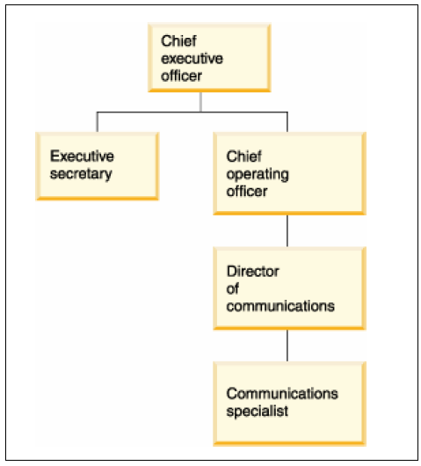
Unbalanced Hierarchy
A hierarchy is unbalanced if it has dimension branches containing varying numbers of levels.
Parent-child dimensions support unbalanced hierarchies.
An unbalanced hierarchy has levels that have a consistent parent-child relationship, but have a logically inconsistent level.
Example: an organization chart.

Slide 88
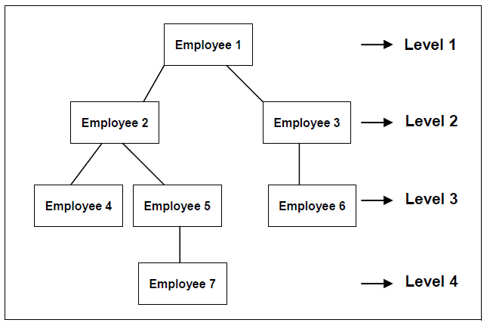
Example of Hierarchical Unbalanced Dimension

Slide 89
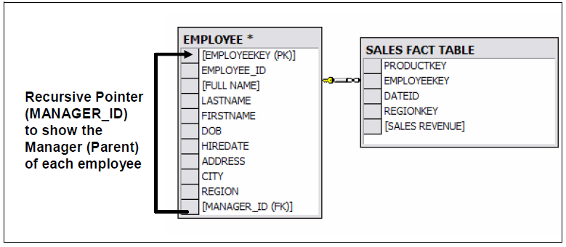
Recursive Pointers
SQL Query very hard or impossible to implement with standard SQL.

Slide 90
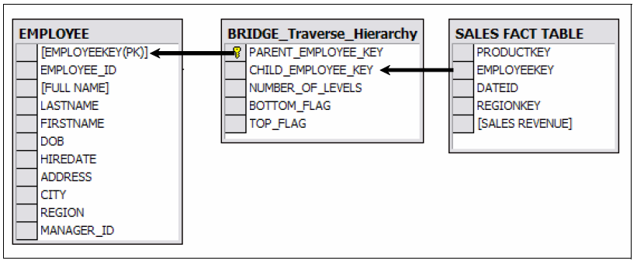
Insert a Bridge Table

Slide 91
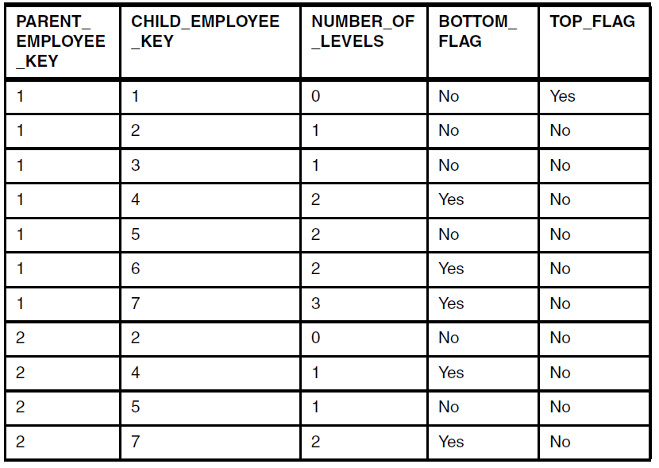
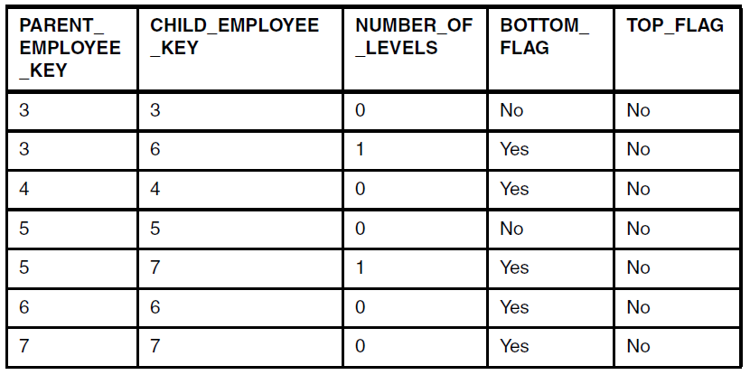
Inside the Bridge Table
Other tables are unchanged!
Optional, needed to support u. hierarchies
Contains all the path from each parent to each of each child

Slide 92
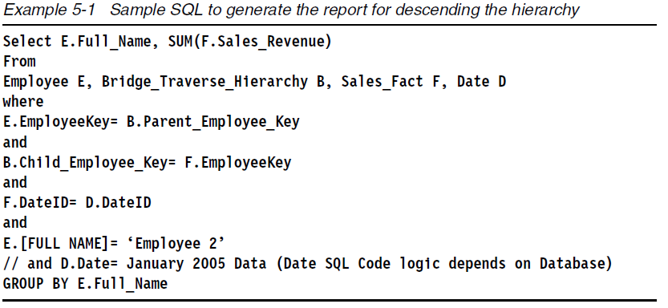
SQL – Descending Hierarchy
If we want to find the total sales revenue during January 2005 for Employee 2 and all its junior employees (Employee 4, Employee 5, and Employee 7).

Slide 93
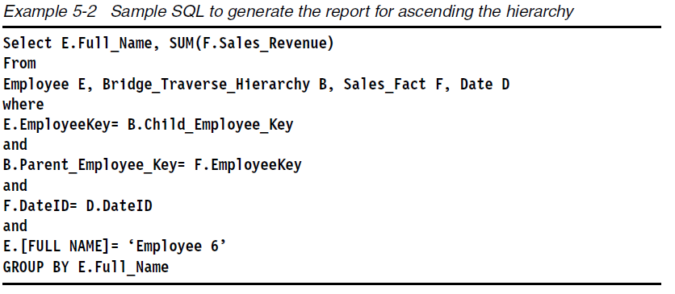
SQL – Ascending Hierarchy
If we want to find out the total sales revenue during January 2005 for Employee 6 and all its senior employees (Employee 3 and Employee 1).

Slide 94
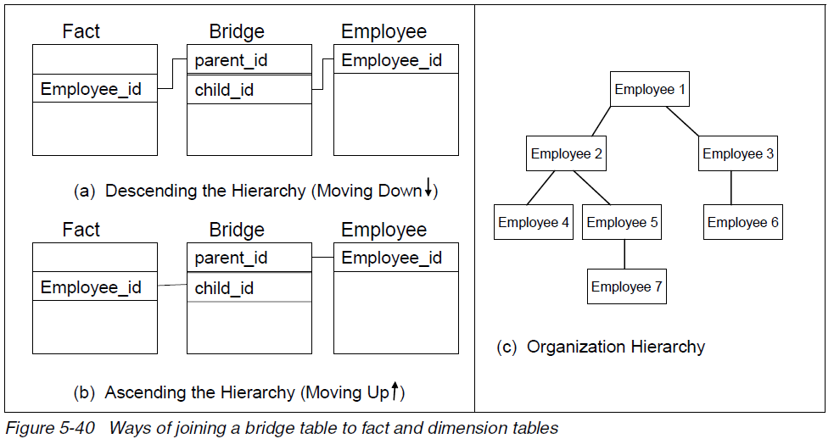
Descending/Ascending - Cont.

